Slide 1
Online Exam System
By: Team 1 - LTIeQ

Slide 2

LTIeQ
Team Details:
S. No. | PS No. | Name
1. | 10671296 | Saurav Tiwari (TL)
2. | 10671294 | Ajay Upadhyaya
3. | 10671420 | Sonali Dudve
4. | 10671465 | Yogesh Narwal
ltieq.noreply@gmail.com

Slide 3

Online Examination System
Online Exam System is a Multiple Choice Questions (MCQ) based examination system. It provides a comfortable to use environment for both test organizers and candidates for the test. It was developed to conduct mass-evaluation by providing :
Automation to the procedure of conducting and evaluating exams.
Security of question set.
Least examination and logistics cost.
Results accuracy and fairness.
Minimum result processing time

Slide 4

Necessity
Remote Accessibility.
Flexibility of Exam Management.
Reduces the workload of Test Organizers.
Secure online sign on and access control.
Result analysis via graphical representation.
Useful in educational as well as in corporate world.

Slide 5
Architecture
MSSQL
All records are stored here in form of tables. It serves as the lowest unit of the program where all data is stored.
WebAPI
Connects MSSQL and Angular, receives information from Angular, returns or performs actions based on it to or from MSSQL
Angular
Presentation layer of the program, connected to WebAPI, sends information requested by the user and displays on the screen
MSSQL
WebAPI
Angular
LTIeQ

Slide 6
What is LTIeQ ?
LTIeQ is a Web Based Online Exam Management System which helps organizations maintain and analyze candidate’s performance in various different tests.
Beneficial for the Educational as well as Corporate firms for conducting mass-evaluations. Recruiting agencies and study centres will also use it for easier evaluation to help students and candidates learn and grow.

Slide 7
Scope of LTIeQ
The main purpose of the system is to evaluate the candidate through a fully automated system which is easily accessible and has a simple flow.
The Admin (Evaluator) with few clicks can upload question sets to the database and can remove or change it based on requirement whenever needed.
Also, Admin can view consolidated as well as student wise report for analysis of performance of different students.
The candidate who logs in using credentials can appear for the test anytime with On-spot results and also analyze his/her subject wise performance based on the different graphs which are generated.
Also, both candidates as well as admin has a feature of downloading the performance reports for future reference and comparative analysis.

Slide 8
Process Flow
Select the Test, in which you want to test your skills. Questions are generated randomly from random set of chosen subject
Scoreboard, report, graphs and report Download
Connect To LTIeQ
Select Your Test
Generate
report
Connect
Create Account
Test Your Skills
User will create an account from the registration page and then Sign in
Automated Test System

Slide 9
UI FLOW
Student
Report
Home
Admin
Admin
Reports
Add/Remove Test
Take Test
Student
Register
Forgot Password
Register
Forgot Password

Slide 10


Home Page
The Admin and Student will login from the Home Screen.
Option For New User Registration is provided at the bottom.
Incase a user has forgot his password, he can request for it to be reset

Slide 11
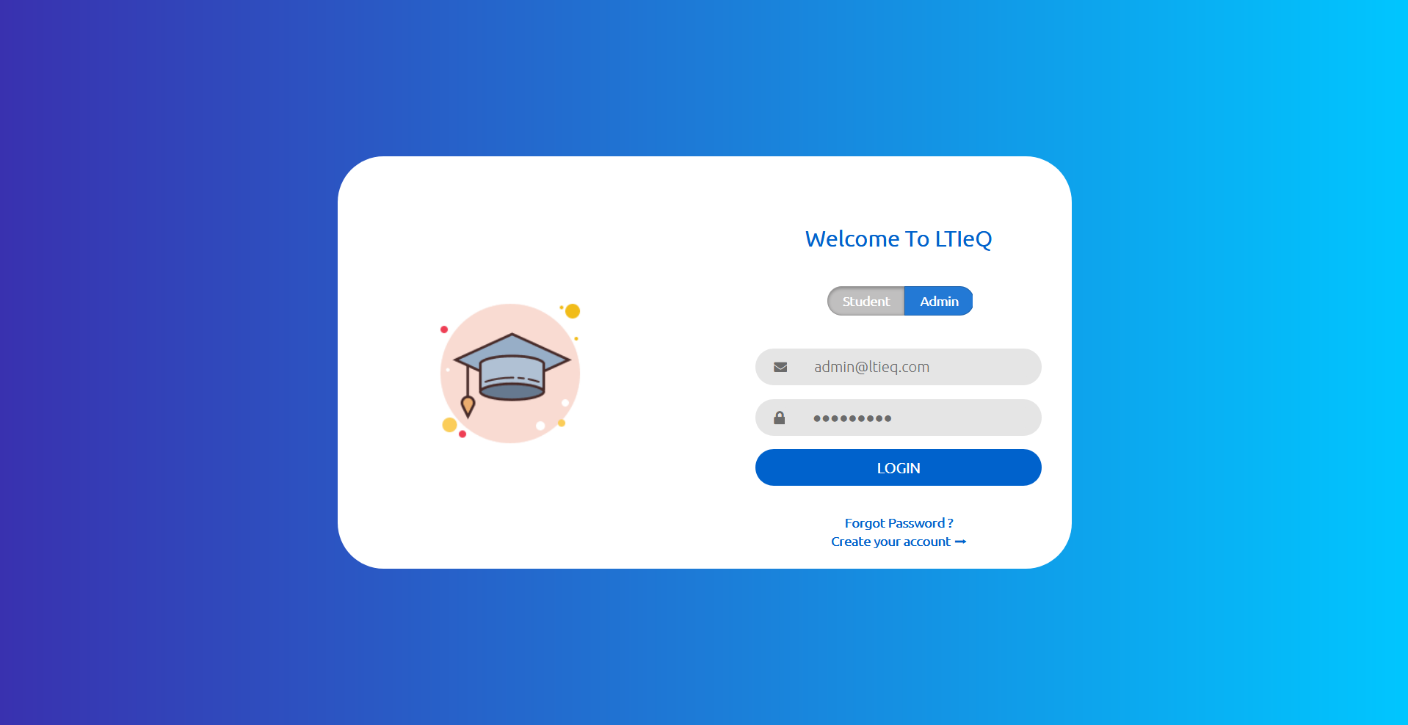
Admin Login
Default admin login Details :
Email – admin@ltieq.com
Password – Necnec>9k

Slide 12
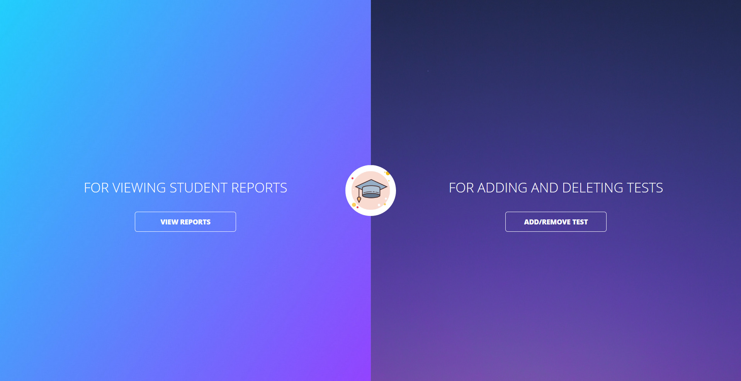
Admin Dashboard
The Admin is presented with two options upon login
View Report : Here the Admin is able to view Reports of all the Users, filter them and even save individual User report.
Add/Remove Test : Here the Admin will add or remove test based as per his requirements.

Slide 13
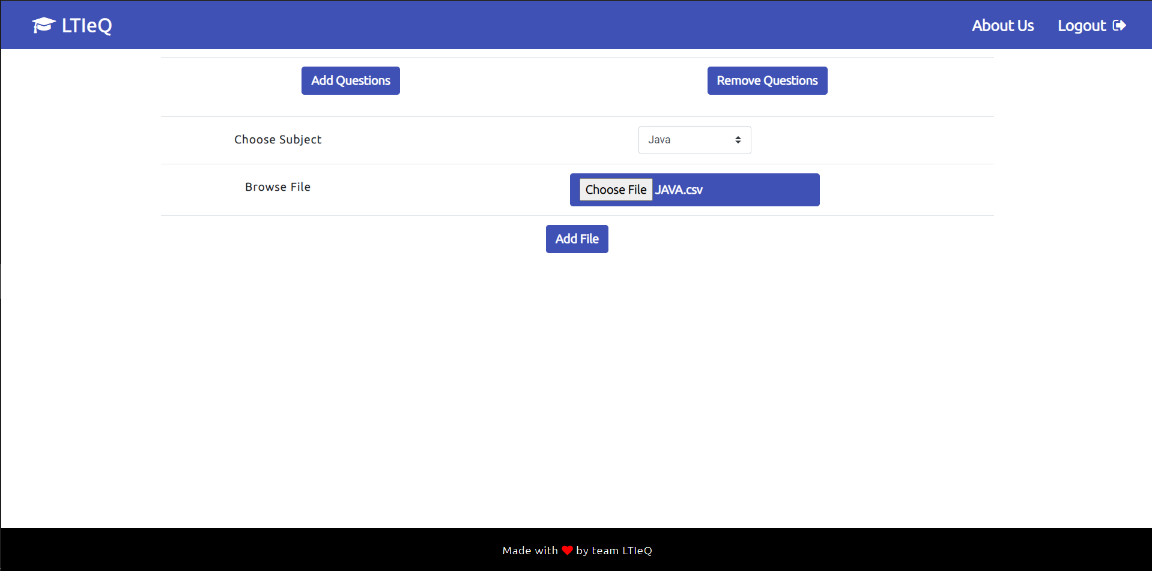
Add/Remove Set
The Admin will add or remove question set as per his requirement.
Add Question – Admin will browse the file in his system and upload the questions to the database.
Remove Question – Admin can remove question set from the database by selecting from one of the available set which can be removed.

Slide 14
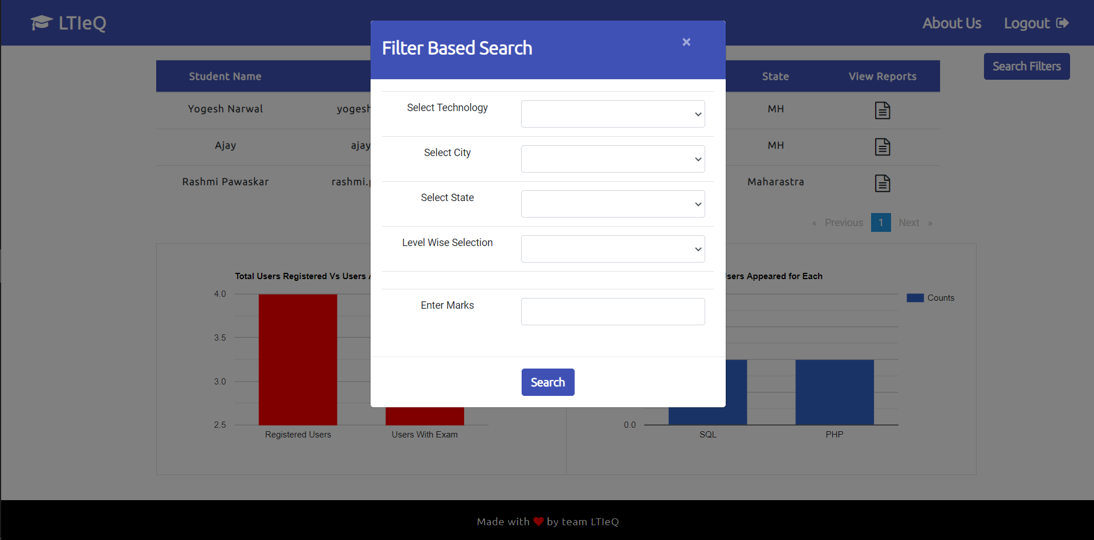
Report
Reports are presented in a manner where the admin is able to view all the students who have given a test.
Admin has the option to search for students with help of the search feature.
Admin will view Individual student records.
Option to Download as PDF has been provided

Slide 15

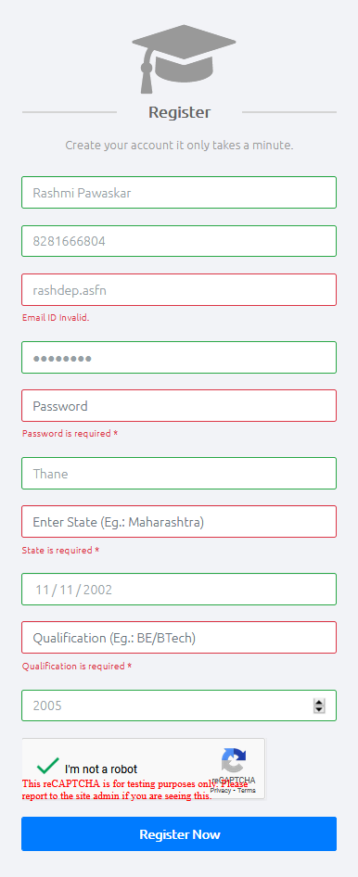
Registration
Users will come to register page, and register themselves.
All types of validations for phone number, Email, password, Date Of Birth etc. have been provided.
User is redirected back to the home screen after successful registration.

Slide 16

Student Login
Students will login with the account they generated after successful registration.

Slide 17
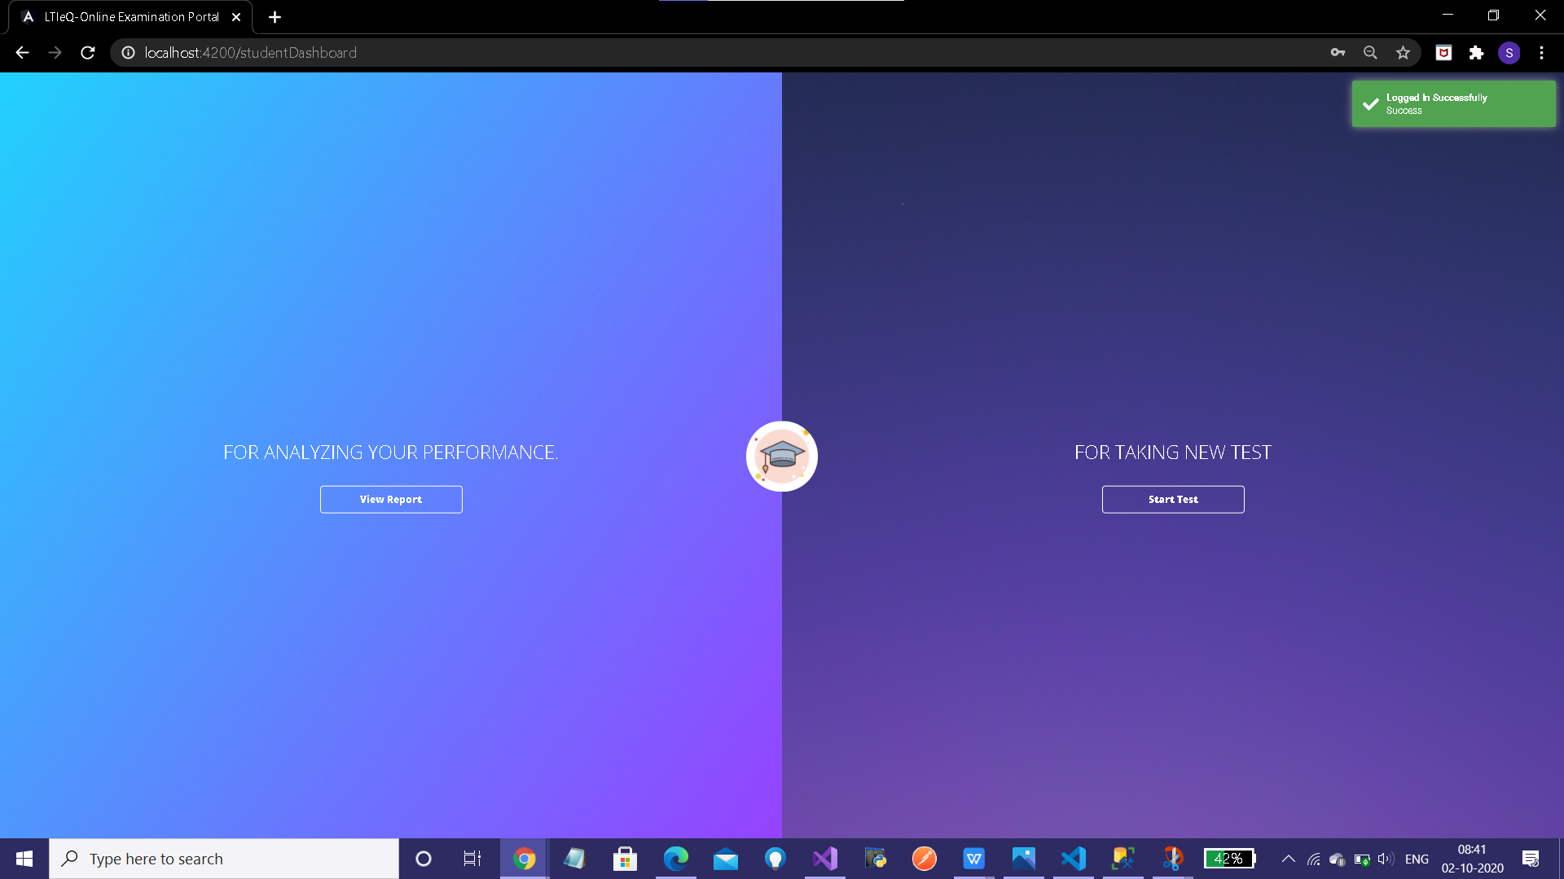
Student Dashboard
The Student is presented with two options upon login
View Report : Here the User is free to look at records of his previous exams he has attempted.
Start Test : Here the User is able to select the test he wishes to give, and then appear for it.

Slide 18
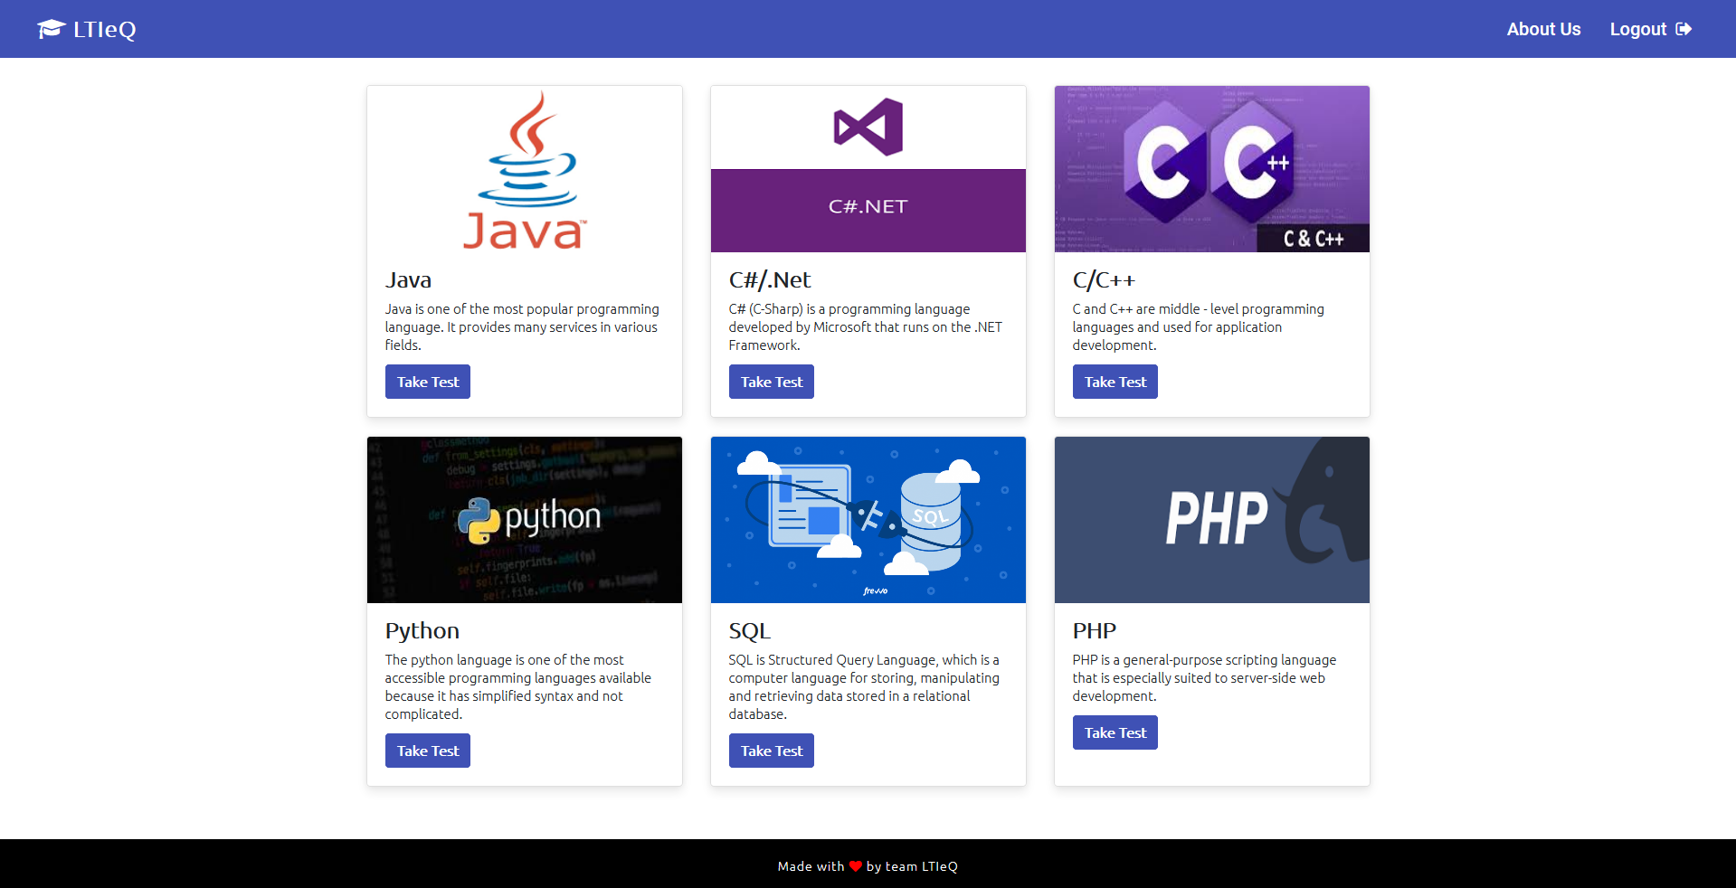
Test Selection
The User is Provided with six options.
Java
C#/ .Net
C/C++
Python
SQL
PHP

Slide 19
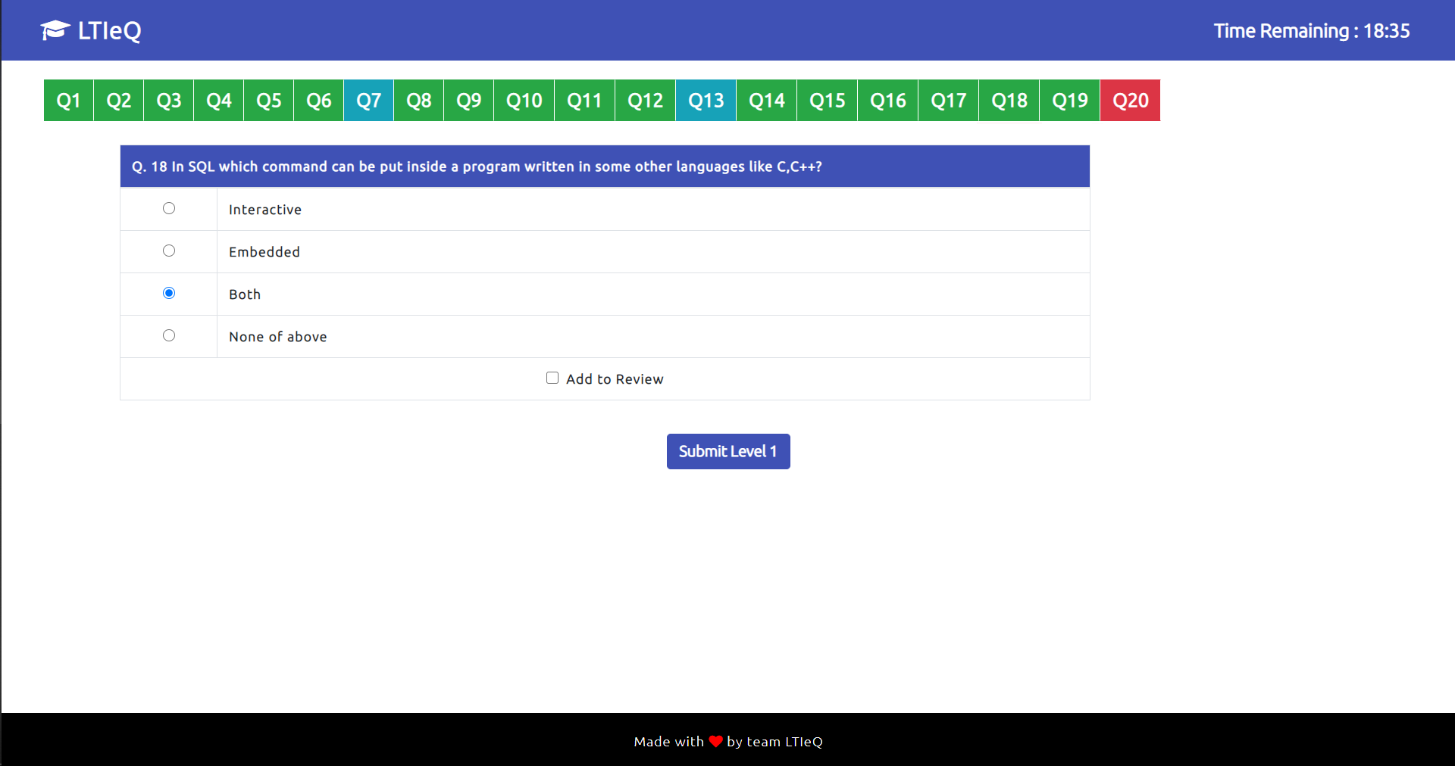
Online Test
The User is allotted questions randomly from one the available set of the subject based on Level 1, Level 2 or Level 3.
Questions are easily navigable from the menu.
Color Code
Not Attempted
Marked For Review
Attempted

Slide 20
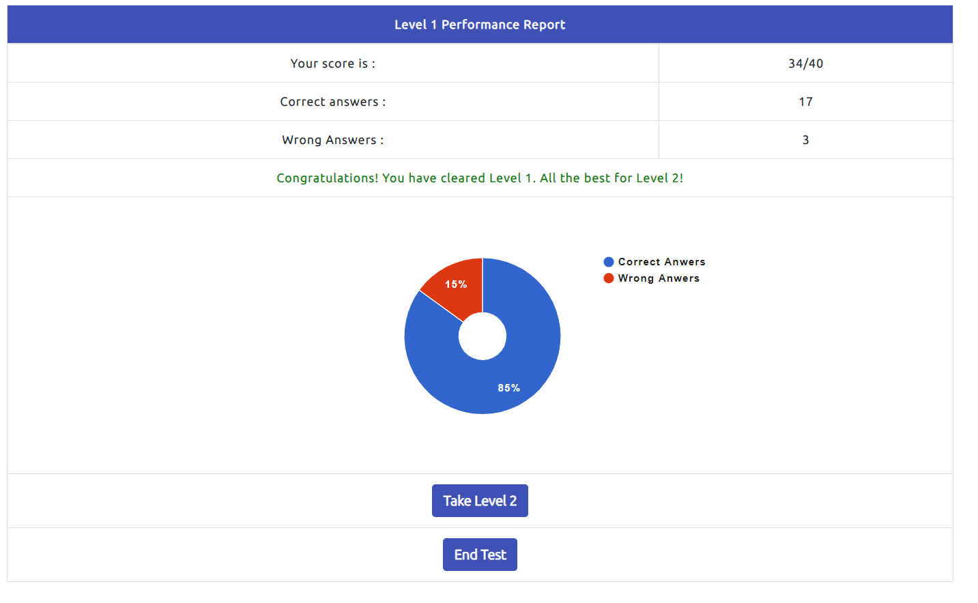
Result
Minimum Cut for each level has been set, which needs to be cleared mandatorily for proceeding to next level.
A donut piechart of Correct and wrong answers given by the student along with his score is provided on the Screen.
The student also has the option to end the test after each level if he wishes to.

Slide 21
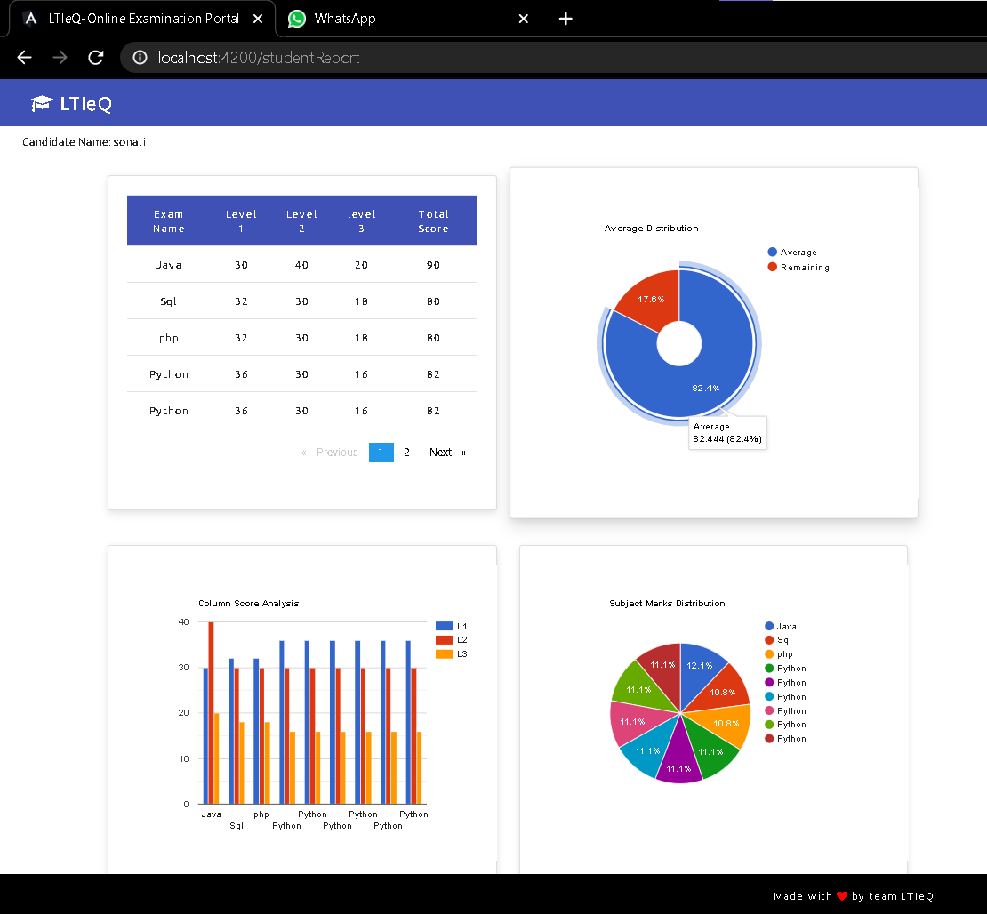
Report
Reports are presented in a manner where the User is able to view his marks based on the test he has attempted
Graph, pie chart and donut pie chart are also provided for the User to average score, his overall marks distribution and level wise score distribution for each subject.
Option to Download as PDF has been provided

Slide 22
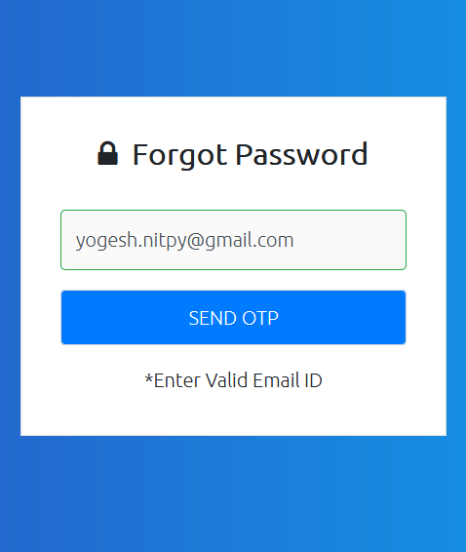
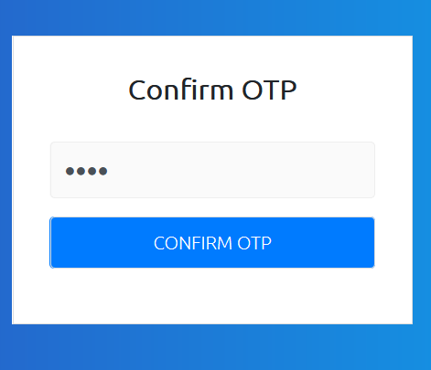
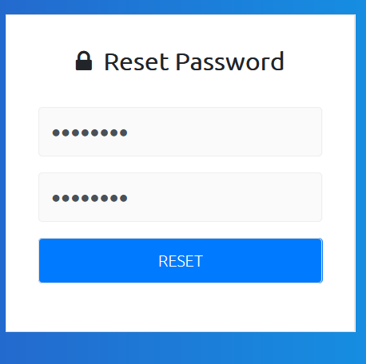
Forgot Password
User needs to enter a valid email ID on which he will receive an OTP
The User will enter the OTP which is confirmed by the system
The User then enters the password which resets his password
The User is redirected to home Screen.

Slide 23
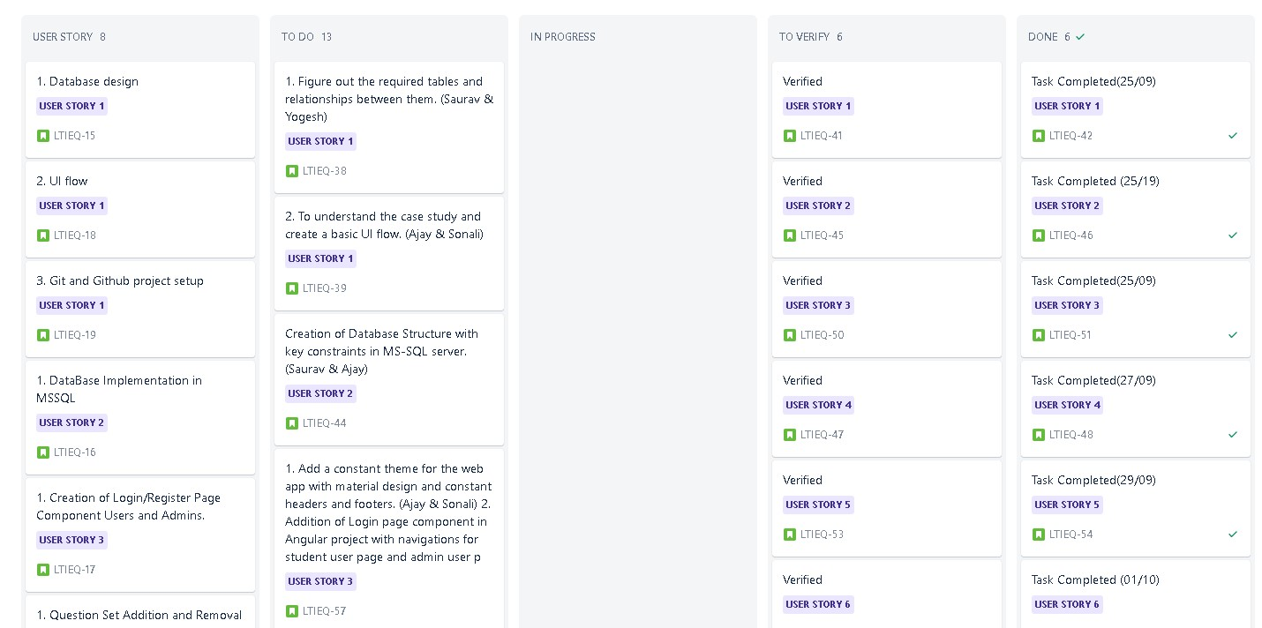
SCRUM

Slide 24
Timeline
25 Sept.
29 Sept.
03 Oct.
Outlay Of Student Module
Bug Fixing, Minor Changes and Testing
Basic Planning and Reading of Case Study
27 Sept.
01 Oct.
05 Oct.
Outlay of Admin Module
Test Conducted and UI implementation
Final Presentation

Slide 25
Message from Team LTIeQ
We would like to thank LTI for providing us with an opportunity to work on such an exciting project.
All of this would have never been possible without the guidance and coordination of Mrs. Iswarya and Suruthi whose constant and valuable arrangement with coordinators and regular feedback assessment helped shape path for us to make this possible
This project helped us use all the skills we have learned during our training period, for which we would like to offer our heart felt wishes to our Instructor Mrs. Rashmi Pawaskar, whose tireless efforts and support helped us reach were we are.
Lastly, We would like to thank everyone in GET 856 batch for their valuable efforts throughout the course of training, where we all helped each other, shared ideas and opinions, which improved our skills, helped when times were low and high, for all the codes, jokes and memes, let us all reach the heights we all want to.
Cheers,
LTIeQ

